Slide 1
L E C T U R E
13
Software Configuration Management
Notes:
This repository of slides is intended to support the named chapter. The slide repository should be used as follows:
Copy the file to a unique name for your course and unit.
Edit the file by deleting those slides you don’t want to cover, editing other slides as appropriate to your course, and adding slides as desired.
Print the slides to produce transparency masters or print directly to film or present the slides using a computer image projector.
Each slide includes instructor notes. To view those notes in PowerPoint, click-left on the View Menu; then click left on Notes View sub-menu. You may need to scroll down to see the instructor notes.
The instructor notes are also available in hardcopy as the Instructor Guide to Accompany Systems Analysis and Design Methods, 5/ed.

Slide 2
Software Configuration Management
Everyone involved in the software engineering
process is involved with SCM to some
extent,
When you build computer
software, change happens.
And because it happens, you
need to control it effectively.
What is it?
Who does it?
Why is it important?
What are the steps?
What is the work product?
How do I ensure that I’ve done it right?
To ensure that quality is maintained
as changes are made, the process is
audited; and to ensure that those with a need to
know are informed about changes, reporting is
conducted.
If you don’t control change, it
controls you. And that’s never good.
When
every work product can be accounted for, traced,
and controlled;
The
Software Configuration Management
Plan defines the project
strategy for SCM.

Slide 3
SOFTWARE CONFIGURATION MANAGEMENT
The output of the software process is information that may be divided into three broad categories:
computer programs (both source level and executable forms);
(2) Documents that describe the computer programs (targeted at both technical practitioners and users), and
(3) data (contained within the program or external to it). The items that comprise all information produced as part of the software process are collectively called a software configuration.

Slide 4
As the software process progresses, the number of software configuration items (SCIs) grows rapidly.
If each SCI simply reproduced other SCIs, little confusion would result. Unfortunately, another variable enters the process—change.
Change may occur at any time, for any reason. In fact, the First Law of System Engineering [BER80] states: “No matter where you are in the system life cycle, the system will change, and the desire to change it will persist throughout the life cycle.”

Slide 5
What is the origin of these changes? The answer to this question is as varied as the changes themselves. However, there are four fundamental sources of change:
New business or market conditions dictate changes in product requirements or business rules.
New customer needs demand modification of data produced by information systems, functionality delivered by products, or services delivered by a computer-based system.
Reorganization or business growth/downsizing causes changes in project priorities or software engineering team structure.
Budgetary or scheduling constraints cause a redefinition of the system or product.

Slide 6
Software configuration management is a set of activities that have been developed to manage change throughout the life cycle of computer software. SCM can be viewed as a software quality assurance activity that is applied throughout the software process.

Slide 7
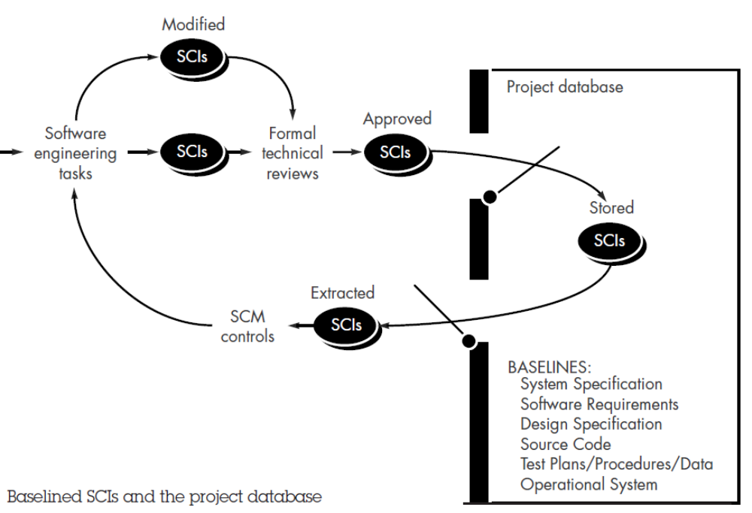

Slide 8
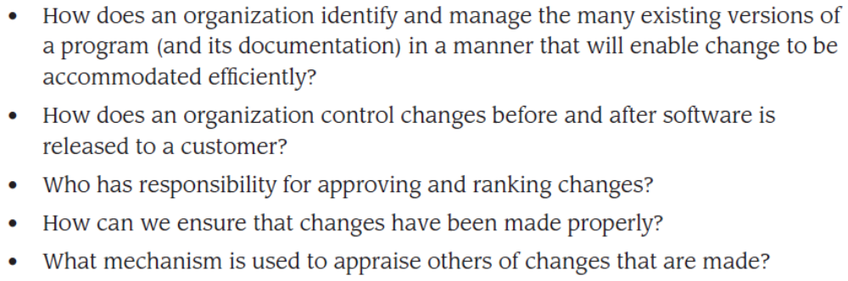
THE SCM PROCESS
Any discussion of SCM introduces a set of complex questions:

Slide 9
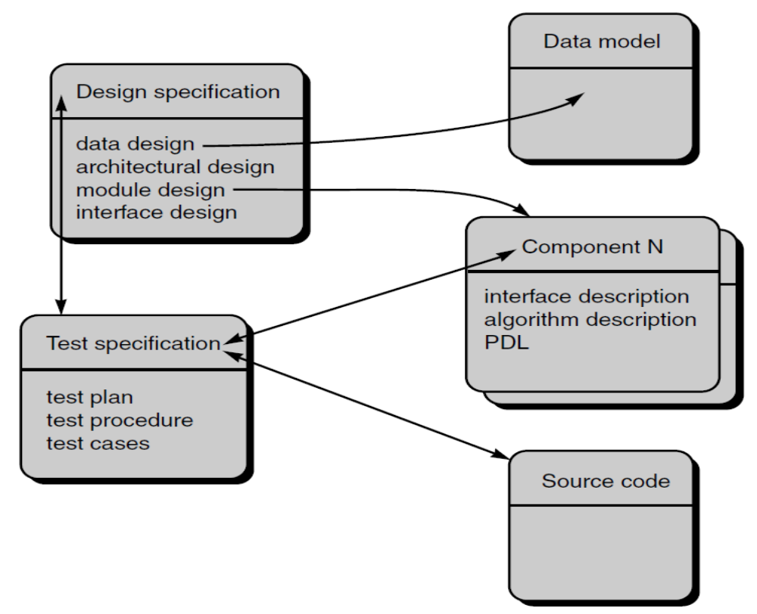
IDENTIFICATION OF OBJECTS IN THE SOFTWARE CONFIGURATION

Slide 10
VERSION CONTROL
Version control combines procedures and tools to manage different versions of configuration objects that are created during the software process. Clemm [CLE89] describes version control in the context of SCM:

Slide 11
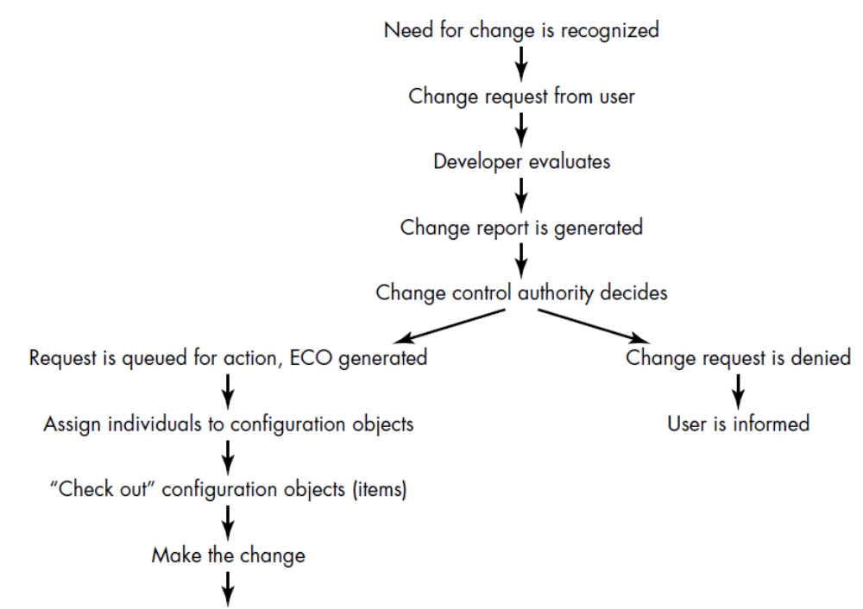
CHANGE CONTROL
The change control process is illustrated schematically in Figure

Slide 12
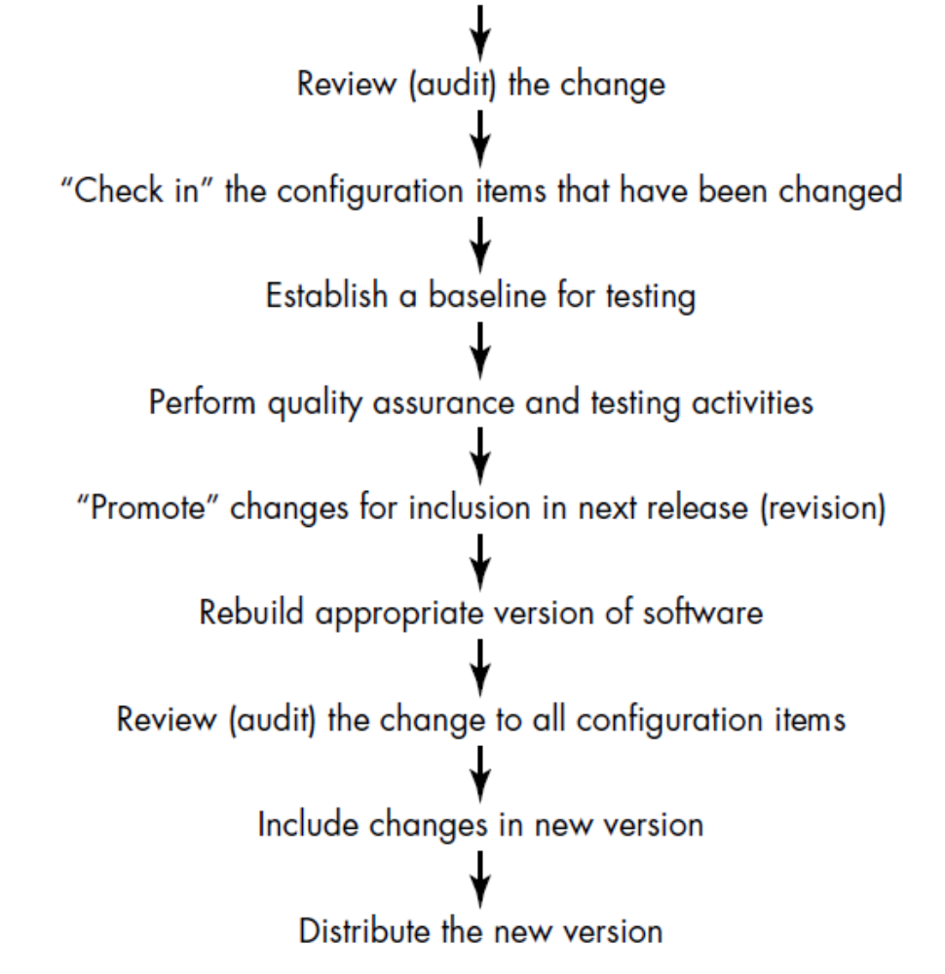

Slide 13
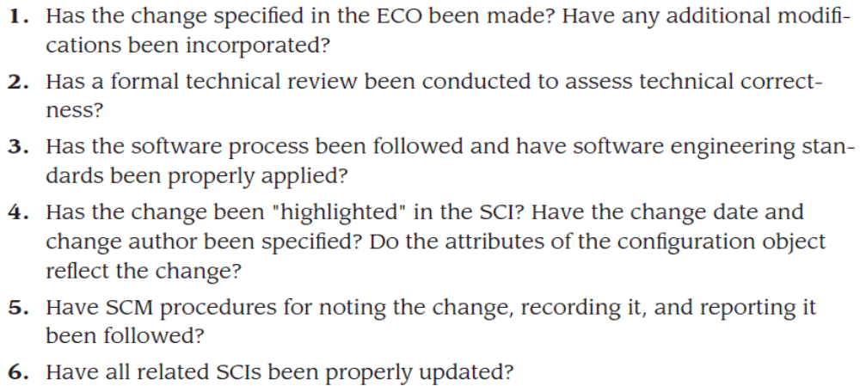
CONFIGURATION AUDIT
What are the primary questions that we ask during a configuration audit?
The audit asks and answers the following questions:
Engineering Change Order

